Slide 1
12.2. – 16.2.2018
Sportovní a podnikatelská střední škola v Plzni

Slide 2
12. února 2018 odstartuje ve škole projekt Edison, který potrvá do pátku 16. února 2018.
Jedná se o pobyt 8 zahraničních stážistů – vysokoškoláků z různých koutů světa.
V dopoledním a odpoledním programu se průběžně během celého týdne zahraniční studenti vystřídají ve všech třídách a představí žákům svoji zemi, kulturu, zvyky…
Komunikačním jazykem bude angličtina.

Slide 3
Škola si od projektu slibuje především rozšíření obzoru žáků, podpoření jejich chuti cestovat a poznávat nové kultury, procvičení anglického jazyka a hlavně ztrátu strachu z neznámého.

Slide 4
Name: Maria Camila Echeverri
Country: Colombia
Hobbies: I really like traveling and getting to know new
cultures and places , I like to talk with people and share
my personal experiences, I also like going to the beach,
I love animals, especially dogs and all the desserts and
sweet food.
Message for students: Its to always keep an open mind and to try to learn as much about their country as the culture of other countries, to be always kind no matter where the person comes from. and to make many friends around the world

Slide 5
Name: Anna Zeladina
Country: Russia
Hobbies: I like history of art, literature and exploring
new places.
Message for students: I am really glad to be part of the
project and I hope to see you soon.

Slide 6
Name: Mechergui Oussama
Country: Tunissia
Hobbies: traveling , backpacking music and sports
Message for students: Live free and make your own
adventure

Slide 7
Name: Huang Ting Yu - Jessie
Country: Taiwan
Hobbies: I like to traveling,listen to music,tasting
delicious food
Message for students: Hi everyone nice to meet you,
hope you'll like the Taiwan's culture which I sharing
and have great time with you guys!

Slide 8
Name: Lee Xuemin - Millee
Country: China
Hobbies: I like music, movies, photography, travelling.
Message for students: I am really happy and glad that
I have the opportunity to be your teacher, to show you
about my country, China. And of course, I want to learn
something about Czech Republic from you guys. Hopefully, I can be not just your teacher, but your friend:* looking forward to meeting you all with my suitcase full of Chinese specialties!

Slide 9
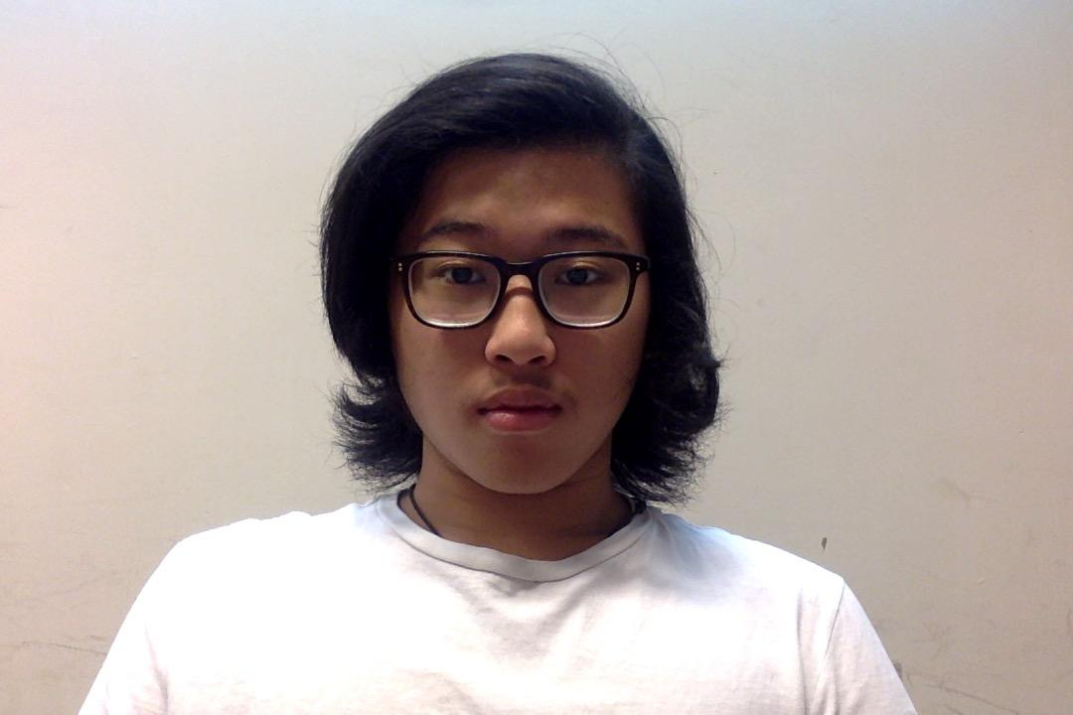
Name: Jonathan Christ Allen
Country: Indonesia
Hobbies: I Like to climb mountains, go travel to parts of
the world, make new friends, and singing
Message for students: I hope we can work together
well and be friends.

Slide 10
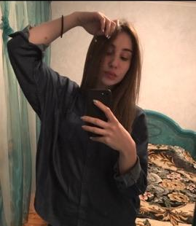
Name: Mari Merabishvili
Country: Georgia
Hobbies: I like working with kids, travelling with foreign
people and learning new things.
Message for students: I have heard you have many castles
in Czech republic so I am looking forward to see them.
Also I would love to taste your best beer. Anyway I am really excited to see you all.

Slide 11
Name: Ali Ogur
Country: Turkey
Hobbies: travelling, exploring new things, books, history
Message for students: Don’t give up your passion or
dreams. It could be anything. People like say you can’t do
this when you say your dreams. because they are jealous
you if you can.and they thinking of impossible.

Slide 12
+
2018

